Slide 1
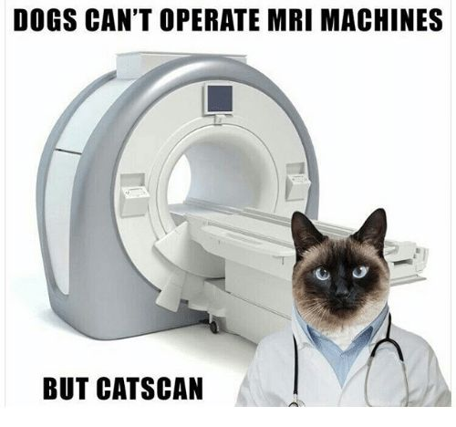
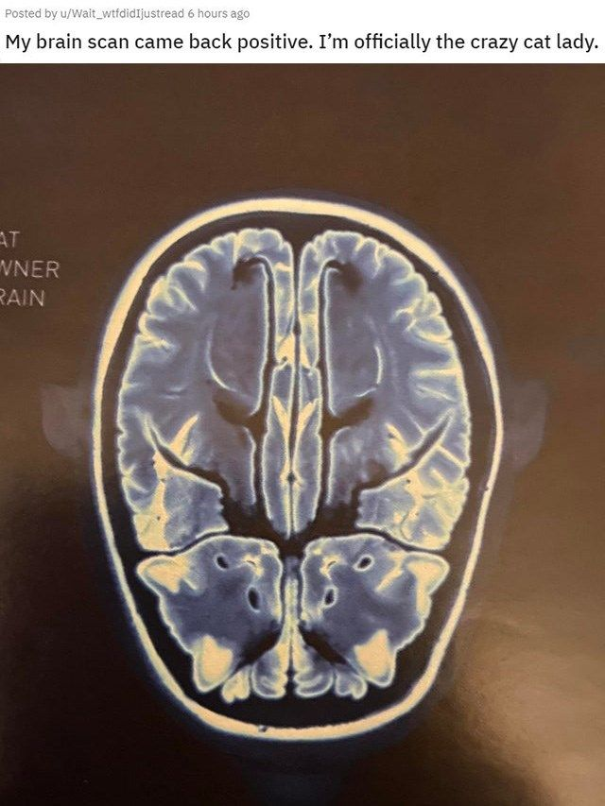
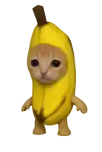

Deep Learning-Based MR Image Reconstruction
and Segmentation
Reconstruction: Mingjian Li Segmentation: Shihang Wei

Slide 2
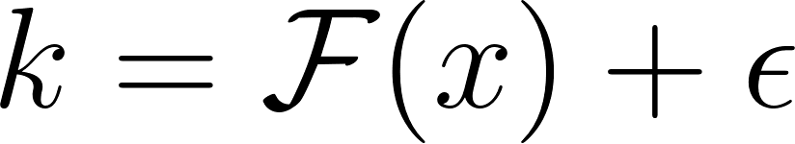
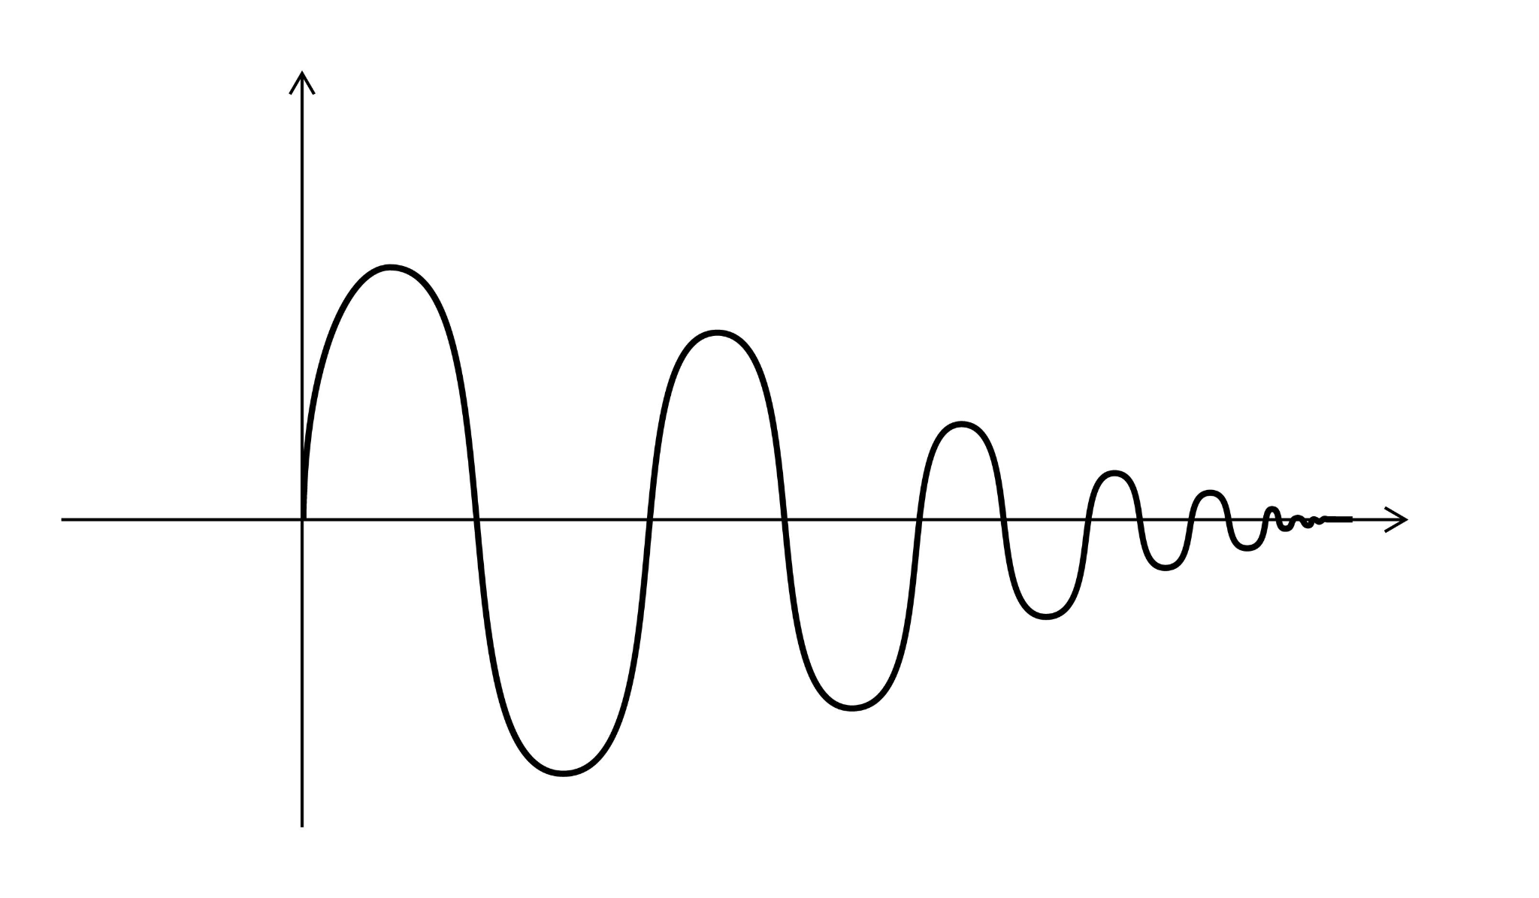
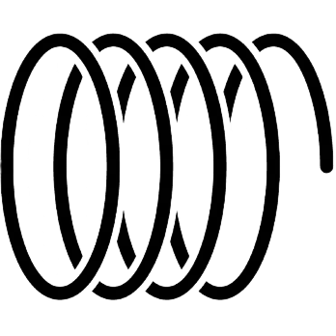
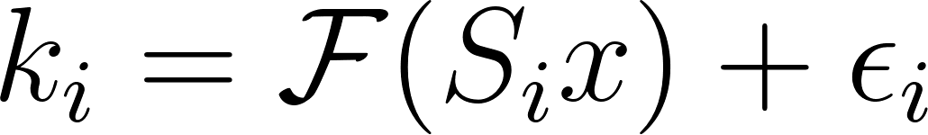
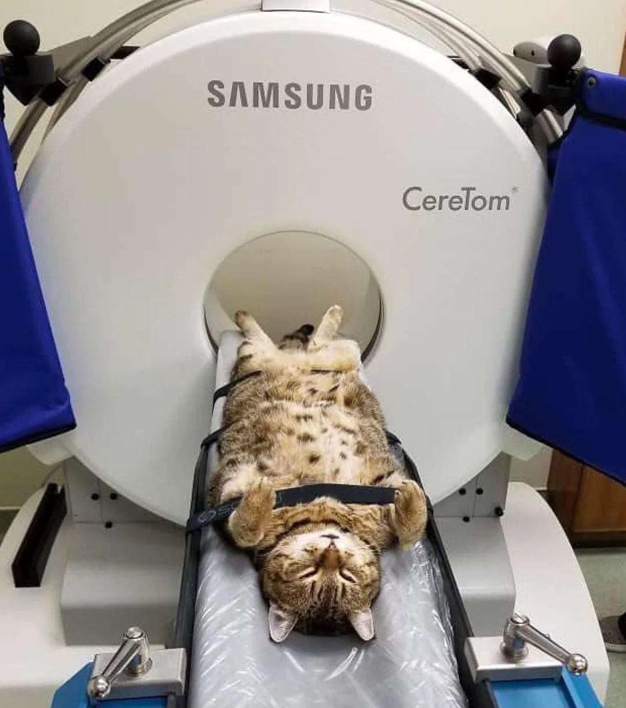
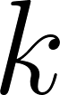
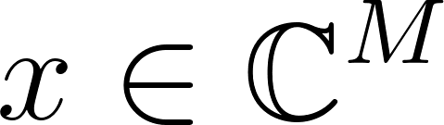
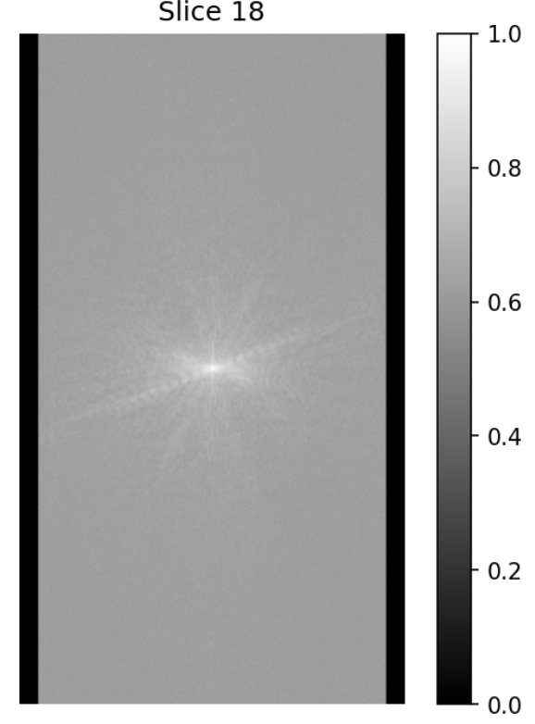
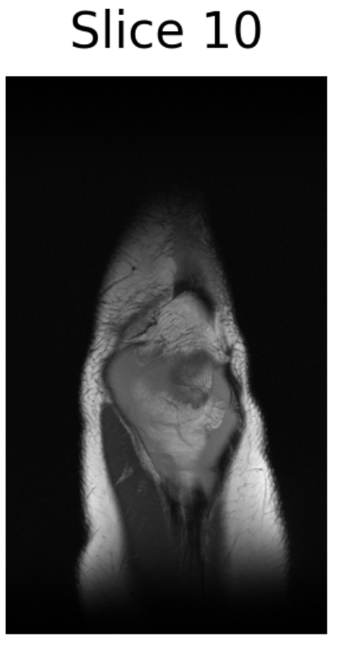
Magnetic Resonance Imaging
Protons
Coils
Signals
k-space ( )
Image ( )
Notes:
MRI works by using a strong magnetic field to align the protons (hydrogen atoms) in the body, which are then temporarily "excited" or tipped out of alignment by a radiofrequency pulse. As these protons relax back to their original state, they emit electromagnetic signals that are detected by receiver coils to construct an image.
Induction: As the protons spin and relax (return to alignment with the magnetic field $B_0$), they generate a changing magnetic field.Voltage: According to Faraday's Law, this changing magnetic field induces a tiny electrical voltage in the receiver coil. That voltage is the signal.The "Squiggle": The signal oscillates (wiggles) because the protons are spinning at a specific frequency (resonance). It decays (gets smaller) over time because the protons slowly go back to their resting state (relaxation).

Slide 3
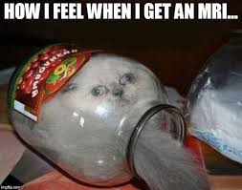
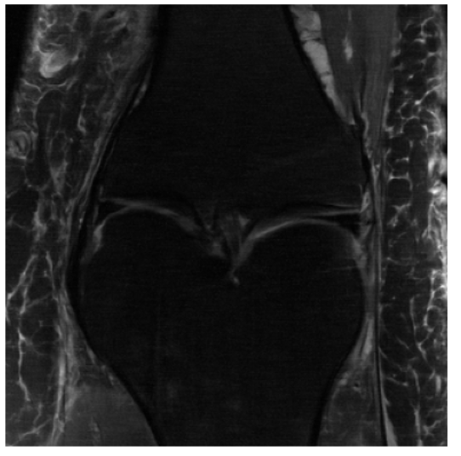
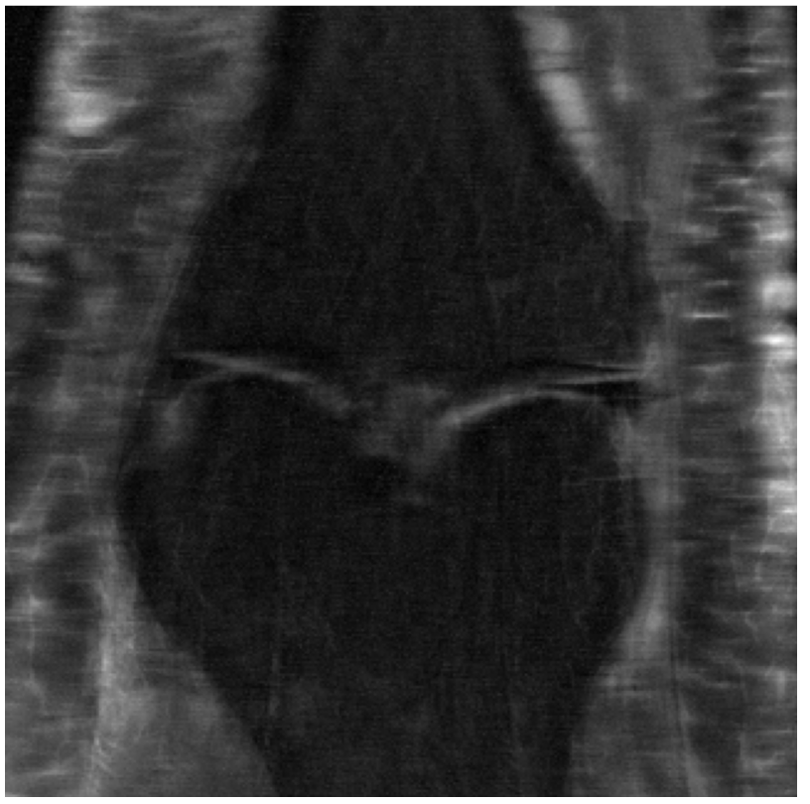
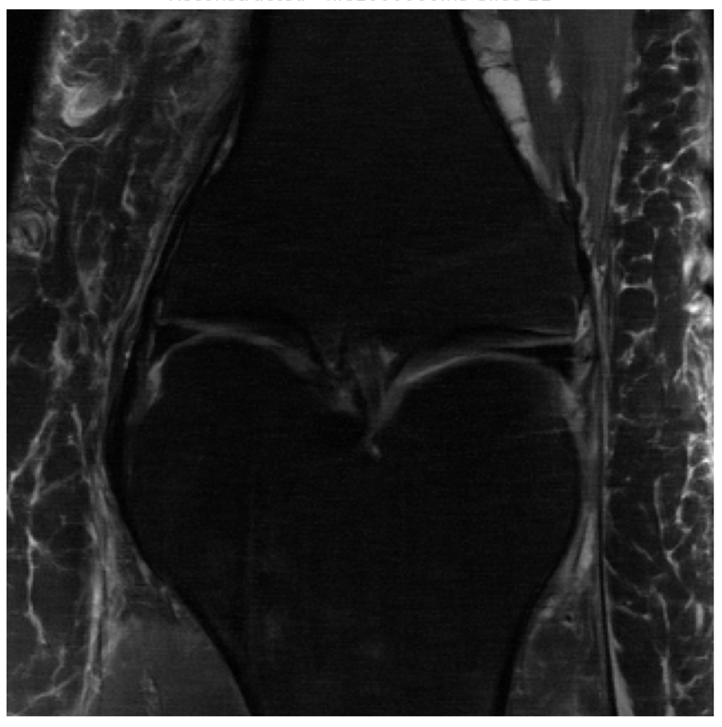
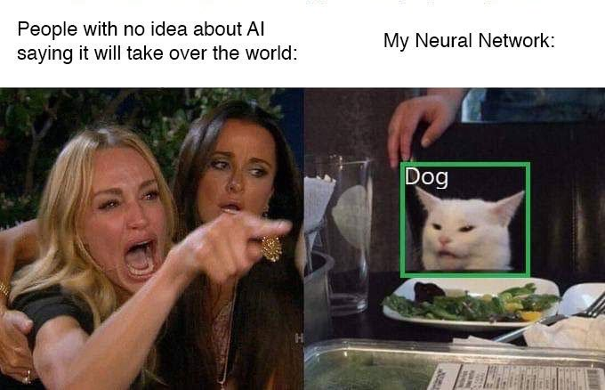
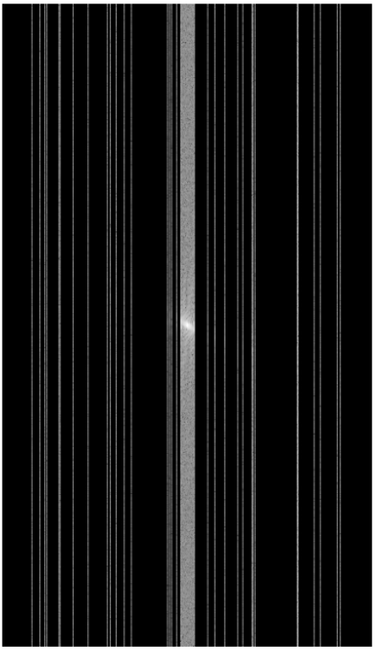
Undersample + Deep Learning
Deep Learning Model
Fully Sampled
Undersampled
Notes:
MRI works by using a strong magnetic field to align the protons (hydrogen atoms) in the body, which are then temporarily "excited" or tipped out of alignment by a radiofrequency pulse. As these protons relax back to their original state, they emit electromagnetic signals that are detected by receiver coils to construct an image.
Induction: As the protons spin and relax (return to alignment with the magnetic field $B_0$), they generate a changing magnetic field.Voltage: According to Faraday's Law, this changing magnetic field induces a tiny electrical voltage in the receiver coil. That voltage is the signal.The "Squiggle": The signal oscillates (wiggles) because the protons are spinning at a specific frequency (resonance). It decays (gets smaller) over time because the protons slowly go back to their resting state (relaxation).

Slide 4
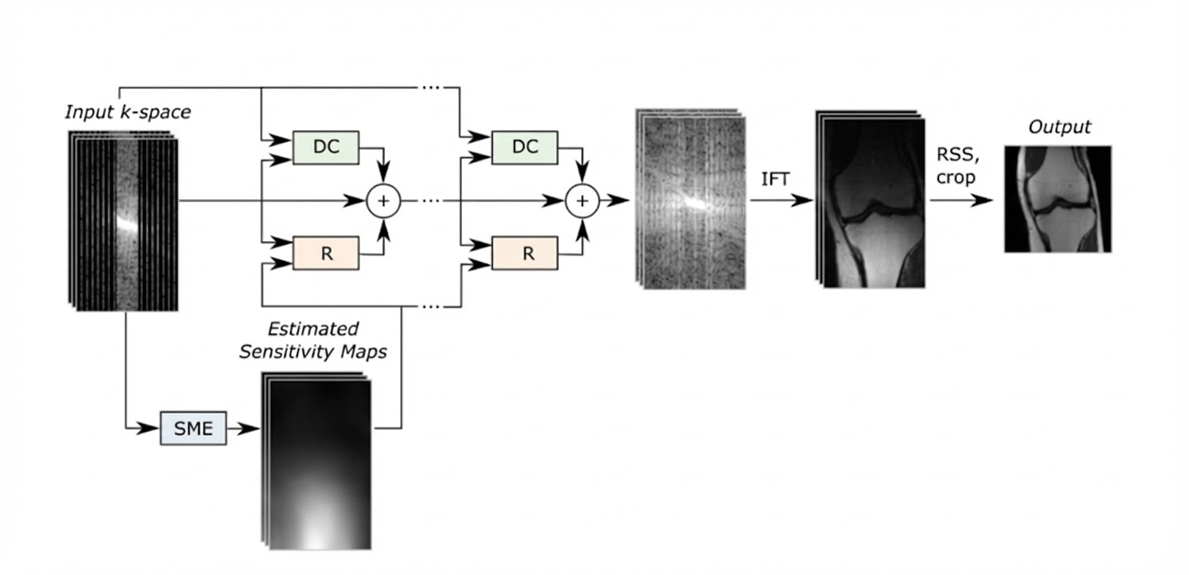
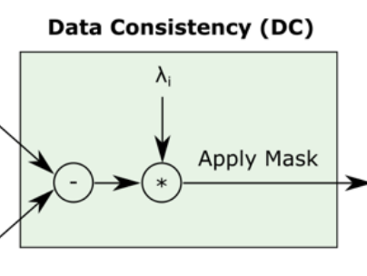
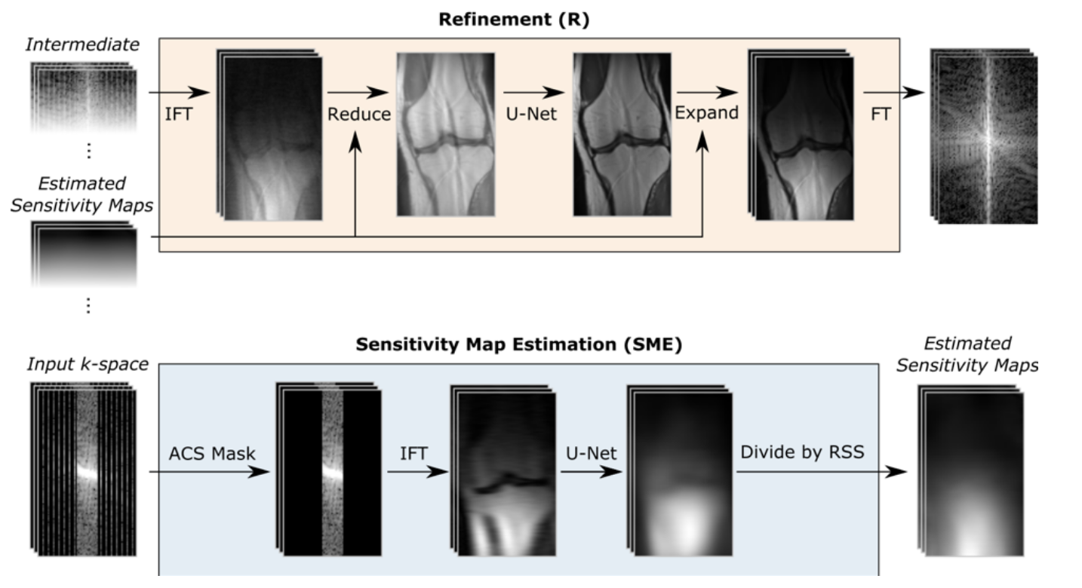
Supervised Learning
End-to-end variational networks for accelerated MRI reconstruction. (Sriram et al., MICCAI 2020)
Physics Constraint
One cascade ≈ one iteration
Notes:
What Does VarNet Learn?
1. Coil Sensitivity Maps
How each receiver coil captures signal from different spatial locations
Learned adaptively from the undersampled data itself
2. Image Priors/Regularization
Each U-Net in the cascades learns what "natural" MRI images look like
Removes aliasing artifacts caused by undersampling
Denoises while preserving anatomical details
3. Data Consistency Weights (dc_weight)
Each cascade has a learnable parameter that balances:
Trust in the measured data (data consistency term)
Trust in the learned prior (U-Net regularization)
The network learns how much to enforce data consistency vs. denoising
4. Unrolled Optimization
The cascade structure mimics an iterative optimization algorithm
But instead of hand-crafted updates, the network learns the update steps
Each cascade refines the reconstruction progressively

Slide 5
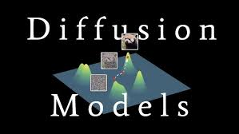
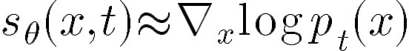
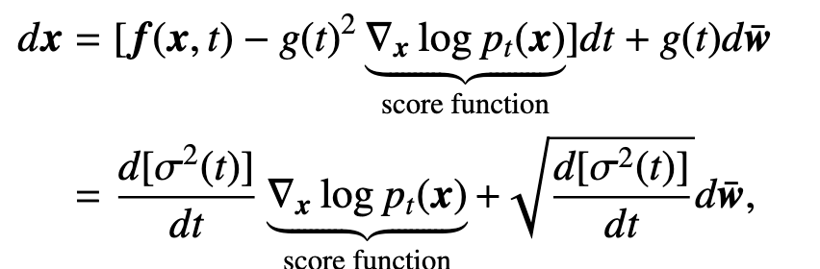
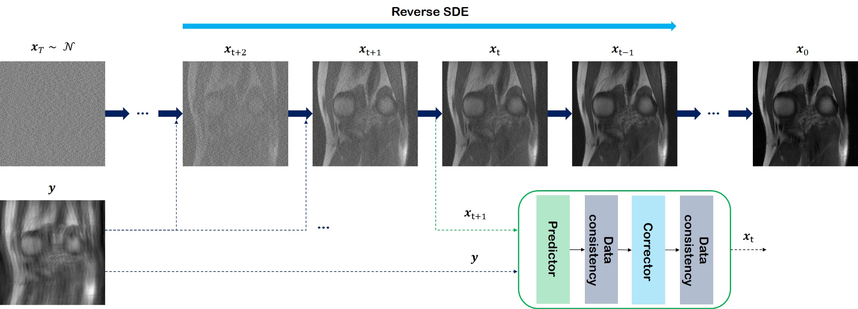
Supervised Learning
Score-based diffusion models for accelerated MRI. (Chung & Ye, 2022)
Notes:
VE: Variational Exploding SDE

Slide 6
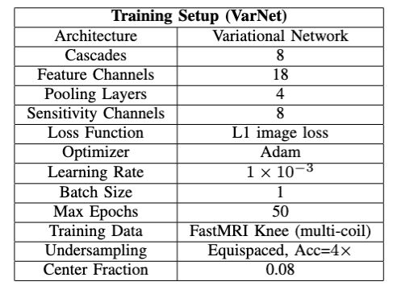
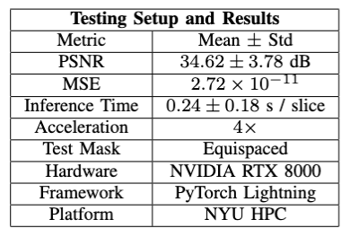
Varnet

Slide 7
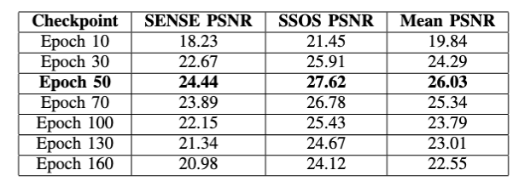
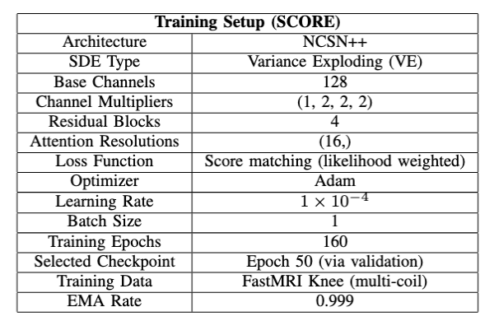
Score-Diffusion Training
My Modification:
TF-Pytorch Conflict;
FastMRI Dataset Adaptation;
Implement SENSE Inference Method
Notes:
NCSN++: A time-conditioned U-Net designed for score-based models SDE Type — Variance Exploding (VE):Noise variance increases over time, Final state is almost pure Gaussian noise

Slide 8
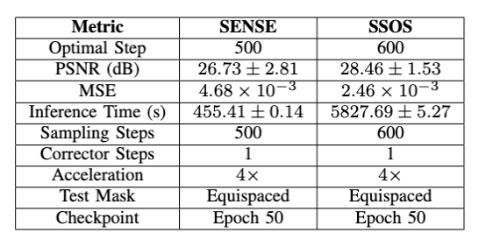
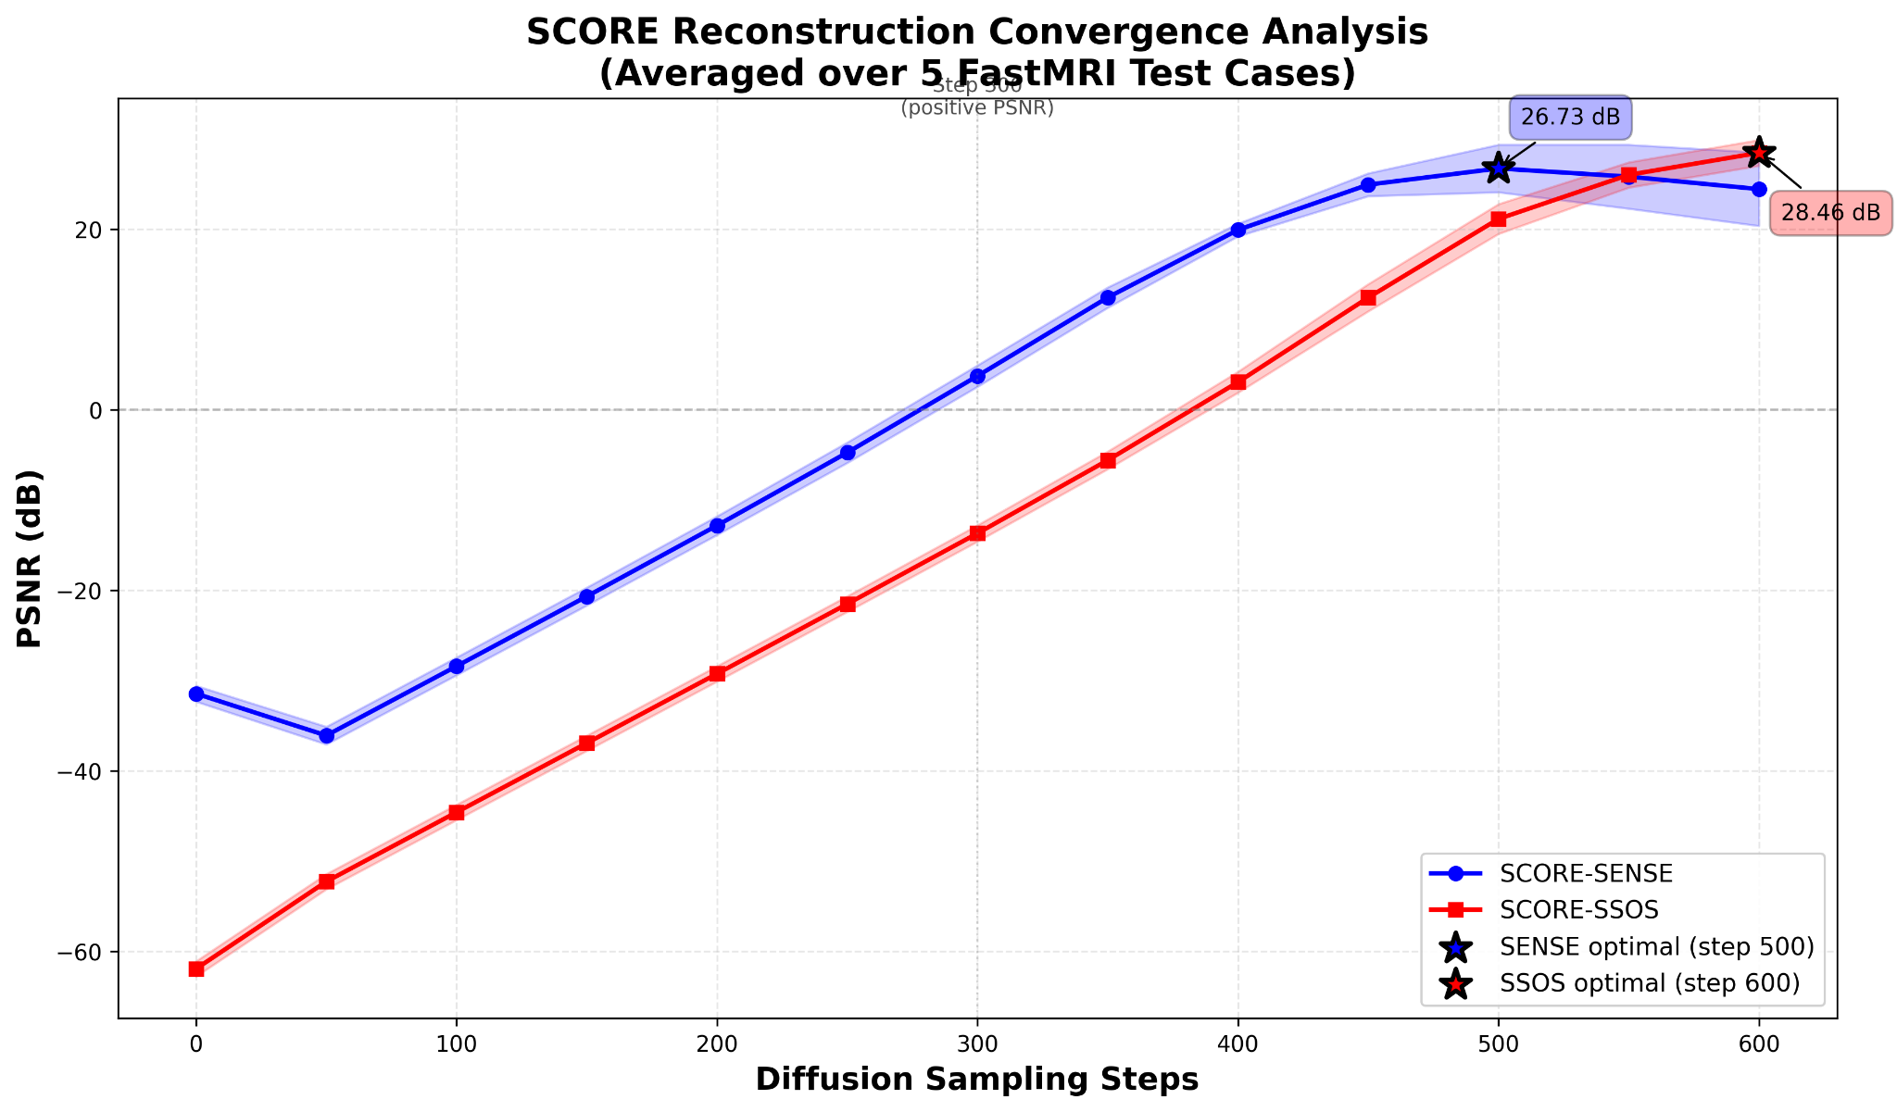
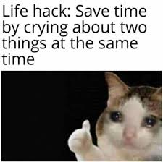
Score-Diffusion Inference
My Key Implementation: 12.5x faster
SSOS: C(# of coils) PC call
SENSE: 1 PC call
Heavy Unet
Heavy Unet
Heavy Unet

Slide 9
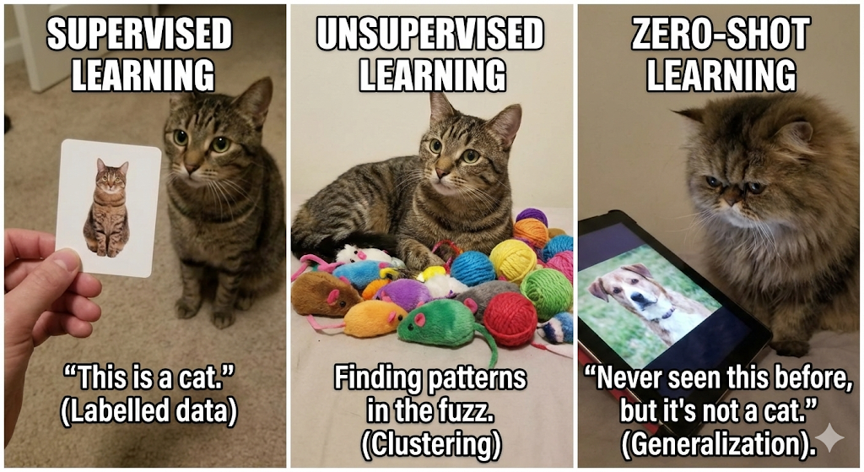
Summary
VarNet achieved the best reconstruction quality and efficiency.
SCORE is more flexible but computationally expensive.
The gap between SENSE and SSOS -> improve coil combination method

Slide 10
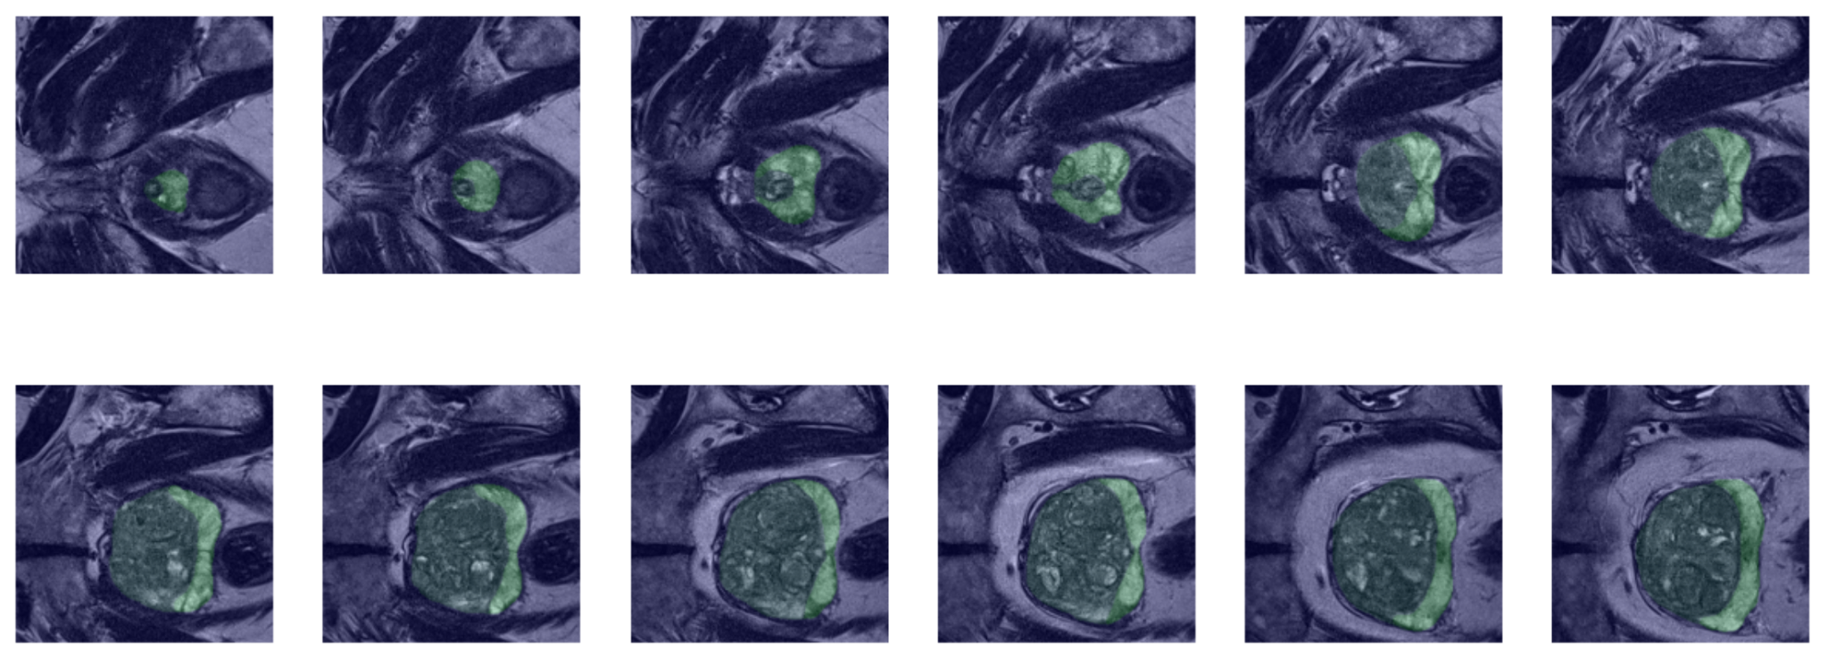
Deep Learning-Based Prostate MRI Segmentation
Goal: Accurate segmentation of prostate zones (PZ, TZ) and specifically tumors
Dataset: Prostate158 using T2-weighted (anatomy) and ADC (diffusion/tumor)
Issues encountered: Prostate tumors are small, sparse, and have very low contrast to noise ratio

Slide 11
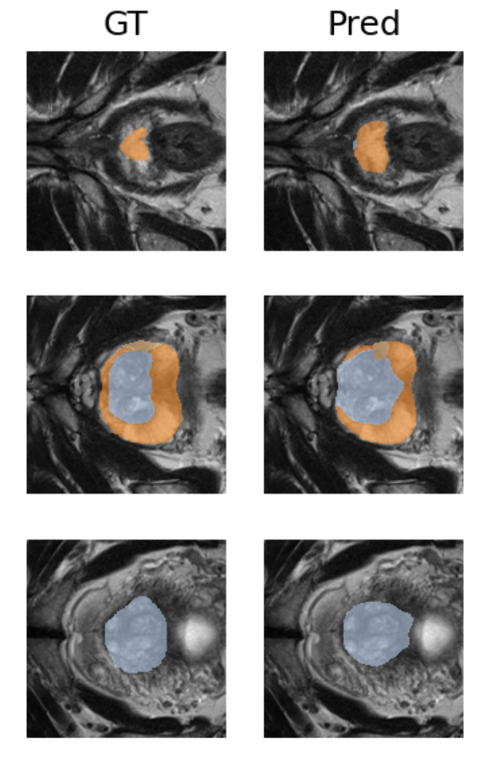
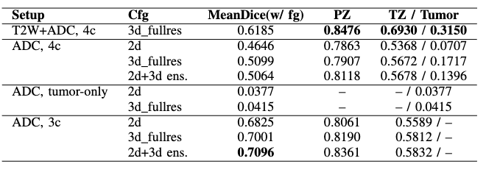
nnU-Net v2
nnU-Net v2: self configuring, automated pipeline design
Pros: Excellent performance on anatomical zones (PZ/TZ) using T2+ADC input
Cons: Struggled significantly with tumors

Slide 12
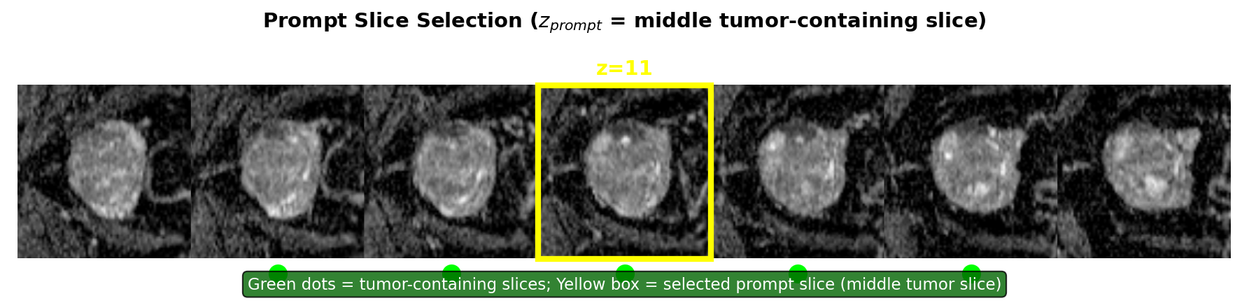
MedSAM2
MedSAM2: a foundation model that treats 3D MRI volumes like video frames
Method: pick middle tumor slice and propagate mask forward and backward

Slide 13
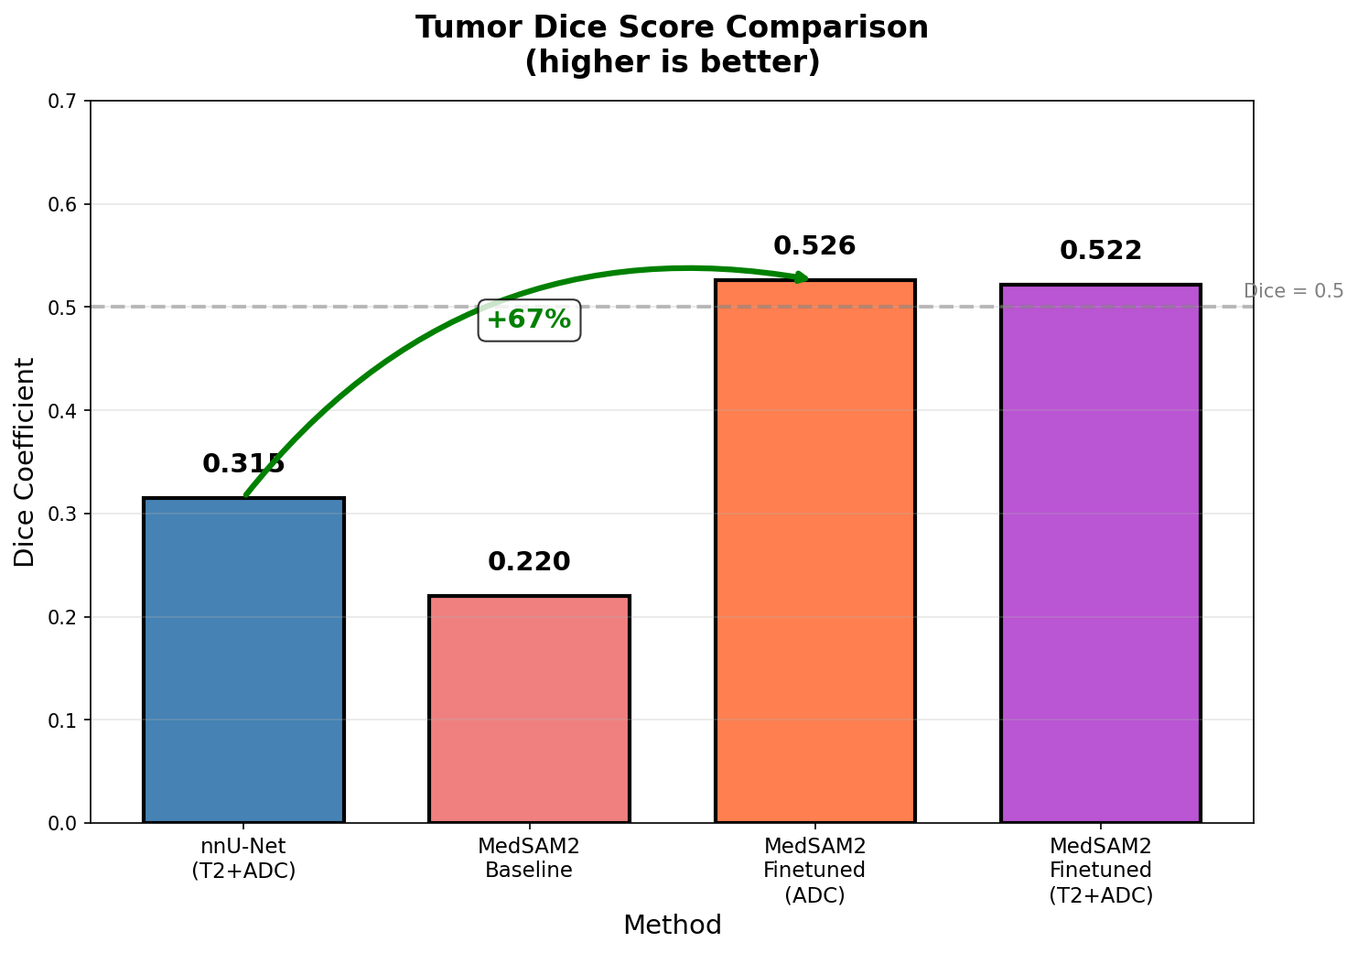
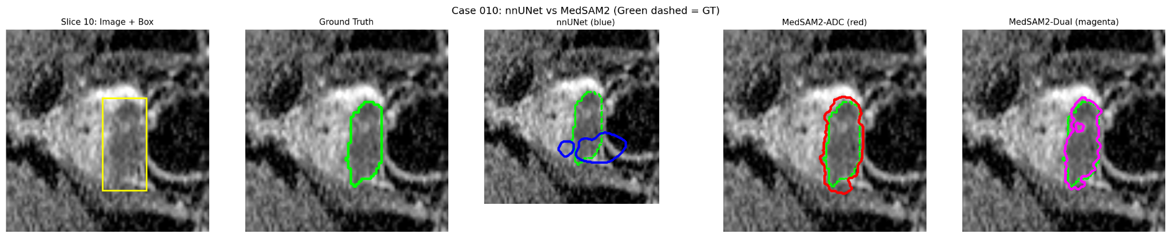
MedSAM2 vs nnU-Net v2
Result:
67% improvement in dice score

Slide 14
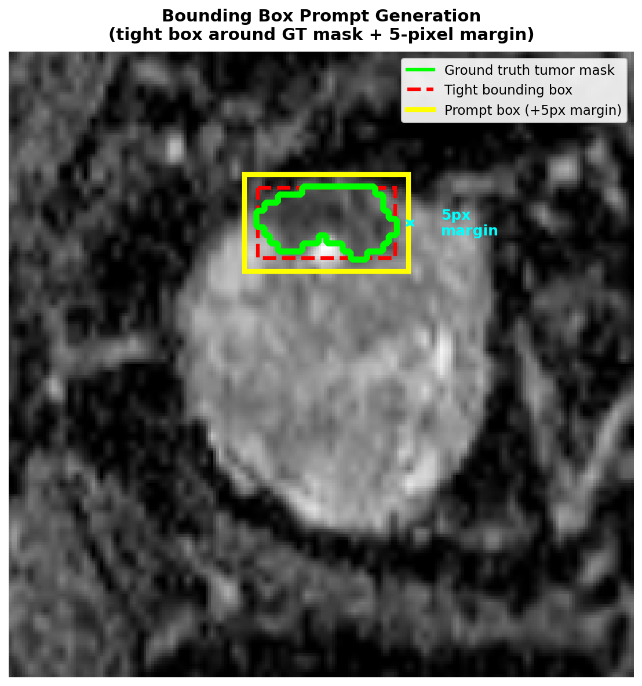
Issue with MedSAM2
Cons: Require a prompt
Our prompt is the bounding box obtained from the GT

Slide 15
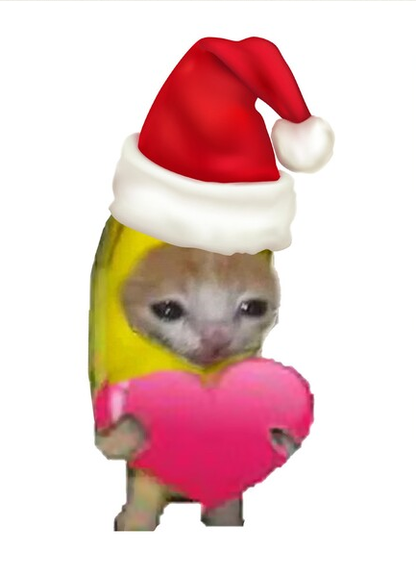

Thank You

